Slide 1
Post Graduate Program
in DevOps

Slide 2
Automated Deployment

Slide 3

By the end of this lesson, you will be able to:
Implement automated and continuous deployment
Deploy a Python application to an application server
Launch a simple java web application using Tomcat
Deploy scripting-based applications like Ruby and PHP

Slide 4
Introduction to Automated Deployment and Continuous Delivery

Slide 5


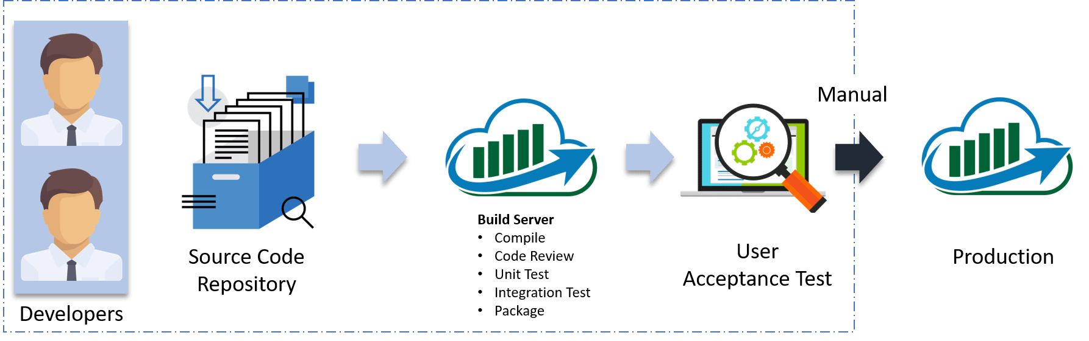

Continuous Delivery
Continuous Delivery is the ability to get changes of all types—including new features, configuration changes, bug fixes, and experiments—into production, or into the hands of users, safely and quickly in a sustainable way.
–Jez Humble
Manual
Build server
Compile
Code review
Unit test
Integration test
Package
User acceptance test
Source code repository
Developers
Production
Notes:
Trainer Notes:
Let me explain the above diagram:
Automated build scripts will detect changes in Source Code Management (SCM) like Git.
Once the change is detected, source code would be deployed to a dedicated build server to make sure build is not failing and all test classes and integration tests are running fine.
Then, the build application is deployed on the test servers (pre-production servers) for User Acceptance Test (UAT).
Finally, the application is manually deployed on the production servers for release.

Slide 6
Benefits of Continuous Delivery
Fast delivery
Low-risk releases
Fast feedback cycle
Flexible release options
Notes:
Trainer Notes:
Fast delivery: Time to market is significantly reduced as customers can use the product as soon as the development is completed.
Fast feedback cycle: Imagine you created a bug in the code, which goes into the production the same day. How much time does it take to fix something you worked on the same day? Probably not much. This, together with the quick rollback strategy, is the best way to keep the production stable.
Low-risk releases: If you release on a daily basis, then the process becomes repeatable and therefore much safer.
Flexible release options: In case you need to release immediately, everything is already prepared, so there is no additional time/cost associated with the release decision.

Slide 7
Automated Deployment
The process wherein any code
change subject to automated tests and other appropriate verifications is immediately
deployed into production.
Build server
Compile
Code review
Unit test
Integration test
Package
Production
User acceptance test
Source code repository
Developers
Notes:
Trainer Notes:
Let me explain the above diagram:
Automated build scripts will detect changes in Source Code Management (SCM) like Git.
Once the change is detected, source code would be deployed to a dedicated build server to make sure build is not failing and all test classes and integration tests are running fine.
Then, the build application is deployed on the test servers (pre-production servers) for User Acceptance Test (UAT).
Finally, the application is manually deployed on the production servers for release.

Slide 8
Benefits of Automated Deployment
Fast delivery
Security
Continuous Improvements
Notes:
Trainer Notes:
Speed — Development does not pause for releases so code is developed really fast.
Security — Releases are less risky, as before releasing, testing is performed, and all bugs are resolved.
Continuous Improvements — Continuous deployment supports continuous improvements which are visible to customers.

Slide 9
Automated Deployment Pipeline
The automated pipeline deployment is a sequence of scripts executed following each change of code committed to the repository. If the process succeeds, the deployment ends in the production environment.
Continuous Integration
Automated Acceptance Testing
Configuration Management
Code
Change
Notes:
Development:
The developers work on the product, often using some Agile technique like Scrum or Kanban. After the implementation, the code is passed to the QA team.
Quality Assurance:
The QA team performs a suite of Integration Testing, Acceptance Testing, and Non-functional Testing.
Any bug detected goes back to the development team.
Operations:
This involves passing the code to the Operations team to perform the release and monitor the production.
If there is a problem, developers are contacted to help the Operations team.

Slide 10
Phases of Automated Deployment Pipeline
Each step below corresponds to a phase in the traditional delivery process:
Continuous Integration: Makes sure that the code written by different developers integrates together.
Automated Acceptance Testing: Replaces the manual QA phase and checks if the features implemented by developers meet the client's requirements.
Configuration Management: Replaces the manual operations phase, configures the environment, and deploys the software.
Notes:
Trainer Notes: Explain the slide

Slide 11
Building the Continuous Delivery Process
Building the Continuous Delivery Process

Slide 12

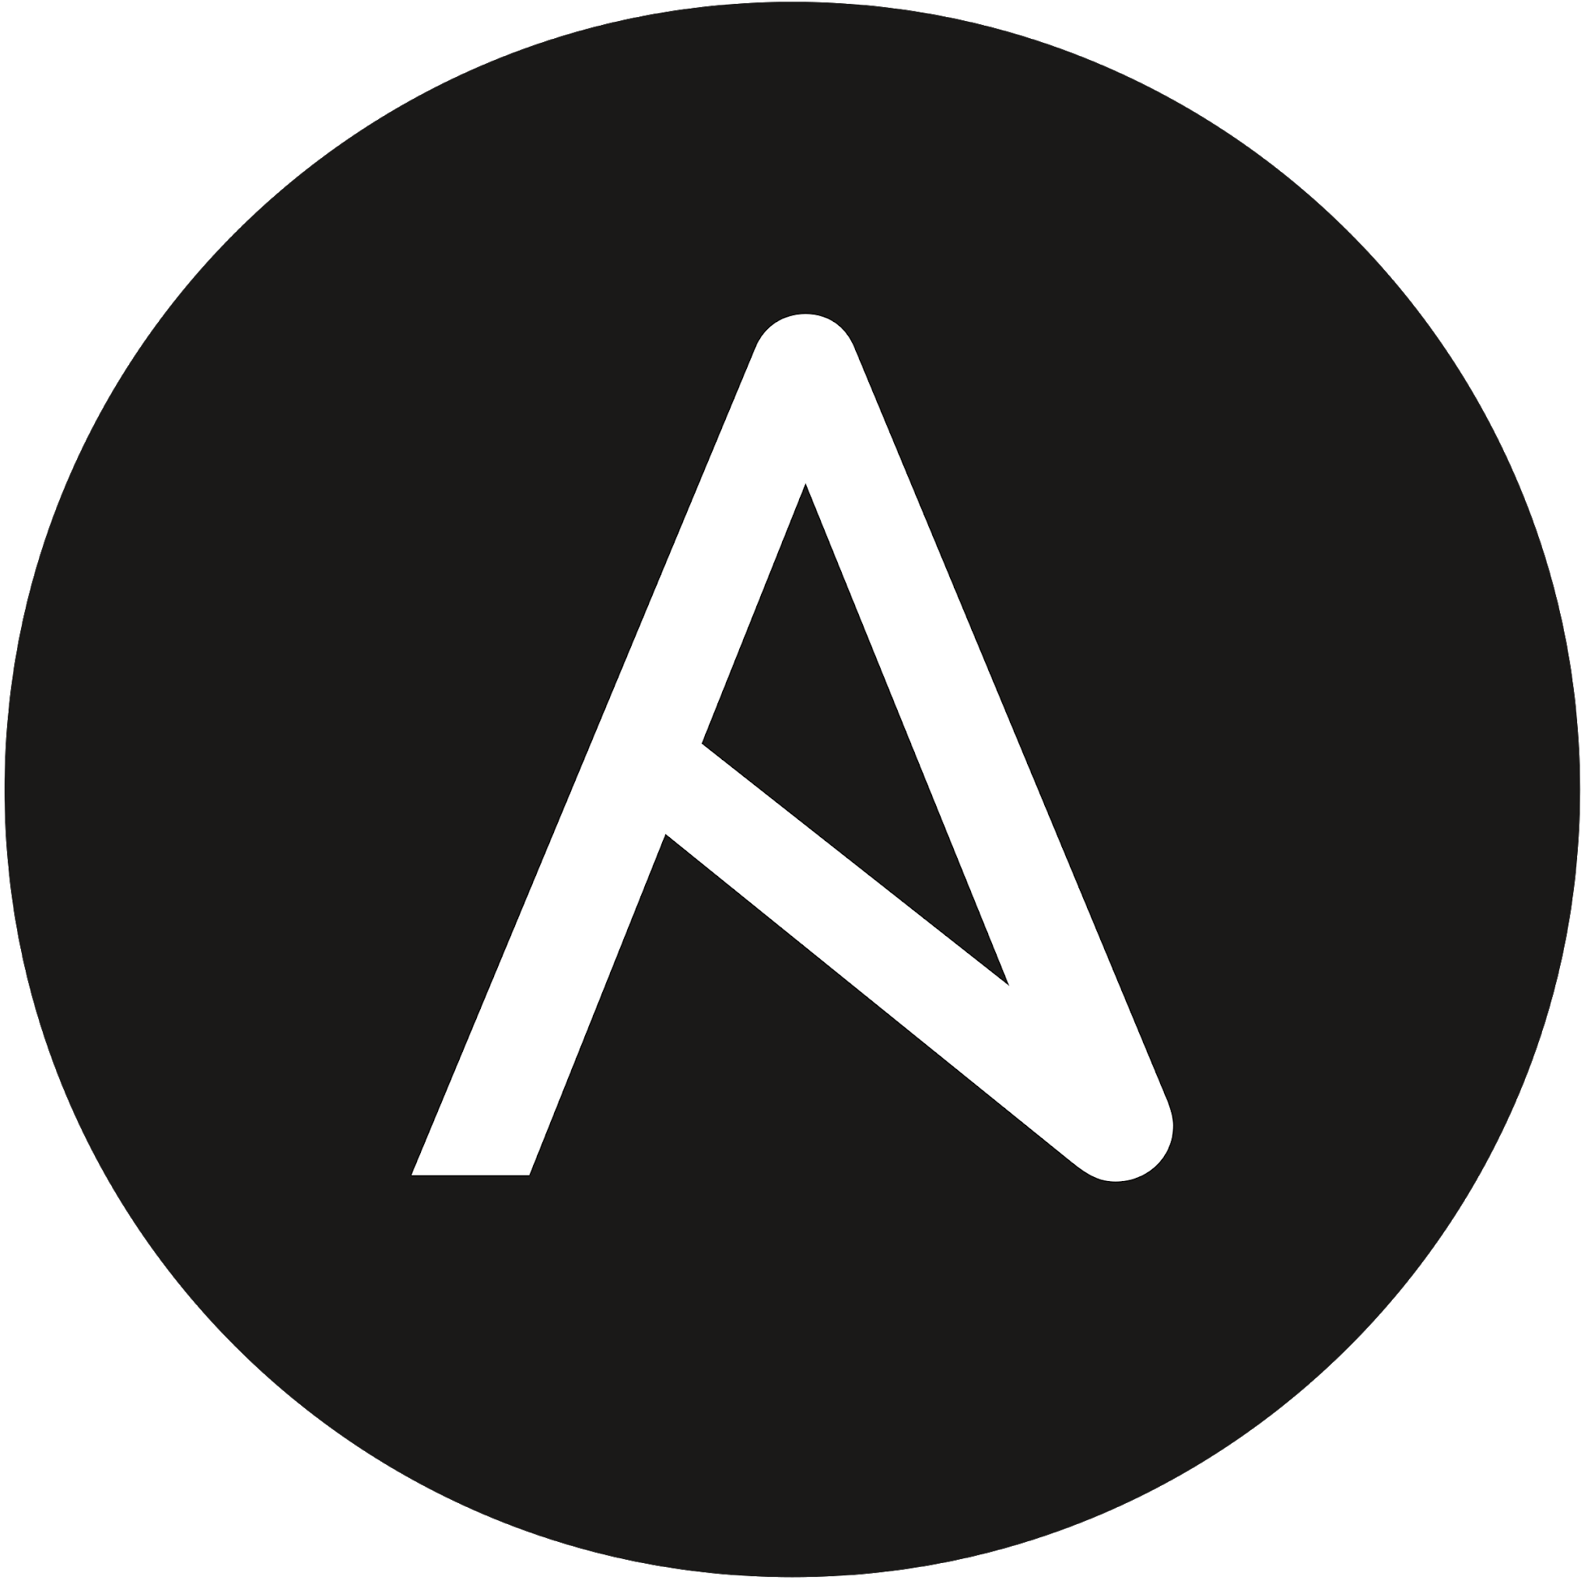

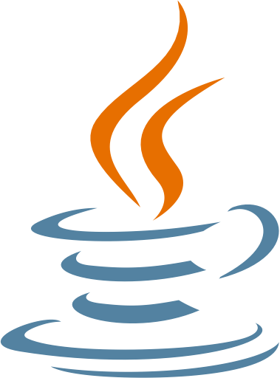

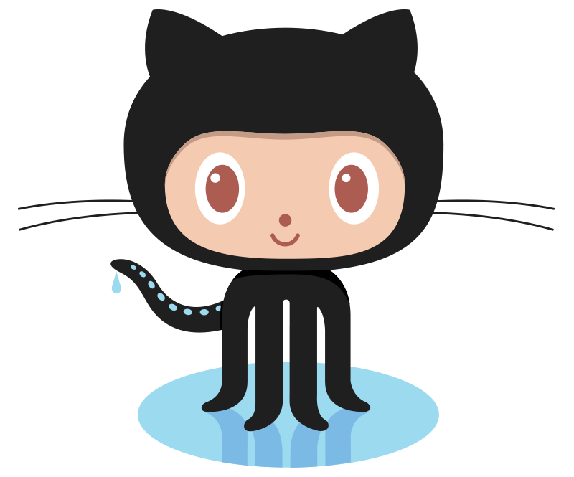
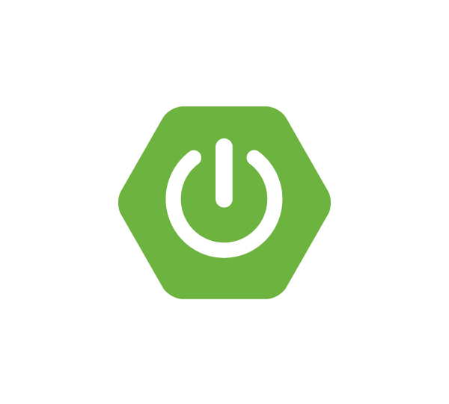

Tools Used
Docker ecosystem
Ansible
Jenkins
Java
GitHub
Gradle
Spring boot
Cucumber
Notes:
Trainer Notes: Explain the slide

Slide 13
Automated Deployment System
Dockerized application
A dockerized application (web service) is made to run as a container on a Docker Host. This is reachable as it would run directly on the host machine.
Jenkins configuration
Docker Host
Continuous Integration
Containerized Application
Automated acceptance testing
Configuration management
Advanced continuous delivery
Notes:
Trainer Notes: Explain the slide

Slide 14
Automated Deployment System
Dockerized application
The Jenkins master accepts a build request, but the execution is started at one of the Jenkins Slave (agent) machines. This provides horizontal scaling of the Jenkins environment.
Jenkins configuration
Continuous Integration
Jenkins
Automated acceptance testing
Configuration management
Jenkins Slave
Jenkins Slave
Jenkins Slave
Advanced continuous delivery
Notes:
Trainer Notes: Explain the slide

Slide 15
Automated Deployment System
Dockerized application
The application is a simple web service written in Java with the Spring Boot framework. Gradle is used as a build tool and GitHub as the source code repository.
Jenkins configuration
Application
Continuous Integration
Repository
Jenkins
Automated acceptance testing
Configuration management
Jenkins Slaves
Advanced continuous delivery
Notes:
Trainer Notes:
The application is a simple web service written in Java with the Spring Boot framework. Gradle is used as a build tool and GitHub as the source code repository.
Every commit to GitHub automatically triggers the Jenkins build, which uses Gradle to compile Java code, run unit tests, and perform additional checks.

Slide 16
Automated Deployment System
Dockerized application
After the application is started on the Docker Host, Jenkins runs a suite of acceptance tests written in the Cucumber framework.
Jenkins configuration
Docker Host
Containerized Application 1
Containerized Application 2
Continuous Integration
Docker Registry
Repository
Jenkins
Automated acceptance testing
Configuration management
Jenkins Slaves
Advanced continuous delivery
Notes:
Trainer Notes: Explain the slide

Slide 17
Automated Deployment System
Dockerized application
Containerized Application 1
Containerized Application 2
Containerized Application 1
Containerized Application 2
Jenkins configuration
Containerized Application 1
Containerized Application 2
Continuous Integration
Staging environment
Production
environment
Automated acceptance testing
Docker Registry
Repository
Jenkins
Configuration management
Advanced continuous delivery
Jenkins Slaves
Notes:
Trainer Notes: Ansible takes care of the environments and enables the deployment of the same applications on multiple machines. As a result, we deploy the application to the staging environment, run the acceptance testing suite, and finally release the application to the production environment, usually in many instances (on multiple Docker Host machines).

Slide 18
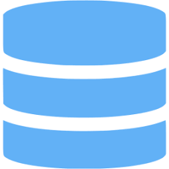
Automated Deployment System
Dockerized application
Staging
Cluster
Production
Cluster
Jenkins configuration
Containerized Application 1
Containerized Application 1
Continuous Integration
Containerized Application 2
Containerized Application 2
Docker Registry
Automated acceptance testing
Repository
Jenkins
Configuration management
Cluster
Advanced continuous delivery
Jenkins Slaves
Notes:
Trainer Notes:
For advanced continuous delivery, single hosts in each of the environment is replaced with clusters of machines. Advanced Continuous Delivery additionally adds databases to the Continuous Delivery process

Slide 19
Implementing Automated and Continuous Deployment

Slide 20
The Deployment Script
Scriptable deployment process is an important part in any automated deployment. Essentially, the deployment stage executes only after the successful completion of the Build and Test stages.
Jenkinsfile (Declarative Pipeline)
pipeline {
agent any
stages {
stage('Deploy') {
when {
expression {
currentBuild.result == null || currentBuild.result == 'SUCCESS’
}
}
steps {
sh 'make publish’
}
}
}
}
Notes:
Trainer Notes:
At this stage of the example Pipeline, both the "Build" and "Test" stages have successfully executed.

Slide 21
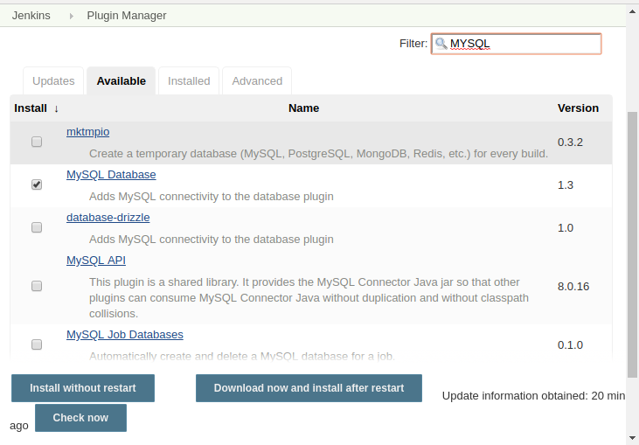
Database Updates: MySQL Plugin
Database plugin adds a system configuration entry to let the administrator configure the database used by Jenkins. MySQL Database plugin is a driver plugin for Database plugin that adds MySQL database driver.
Notes:
Trainer Notes: Explain the slide

Slide 22



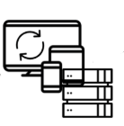

Smoke Tests
A series of automated smoke checks must be executed for any significant automated implementation. An automated acceptance test subset can be a good smoke test candidate.
CI/Pre-QA
Smoke Tests
Developers
Notes:
Trainer Notes:
Smoke testing is a process where the software build is deployed to QA environment and is verified to ensure the stability of the application.

Slide 23
Hot Deploy
Hot deployment is the process of adding new components (such as WAR files, EJB Jar files, enterprise Java beans, servlets, and JSP files) to a running server without having to stop the application server process and start it again.
Notes:
Trainer Notes:
Explain hot deploy

Slide 24
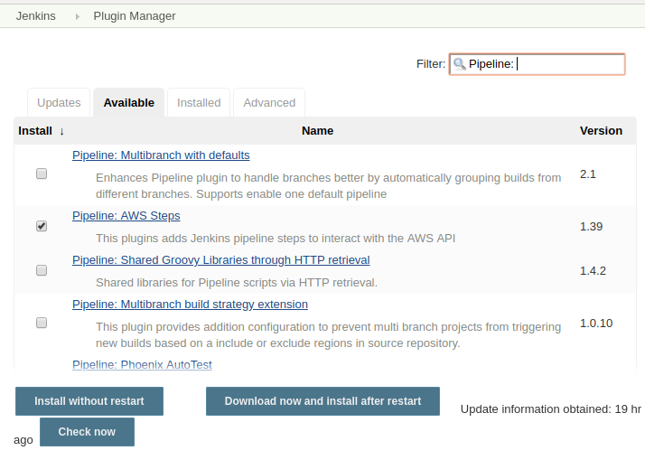
AWS Pipeline
AWS pipeline plugin adds Jenkins pipeline steps to interact with the AWS API.
Notes:
Trainer Notes: Explain the slide
Amazon Web Services is a subsidiary of Amazon that provides on-demand cloud computing platforms and APIs.

Slide 25
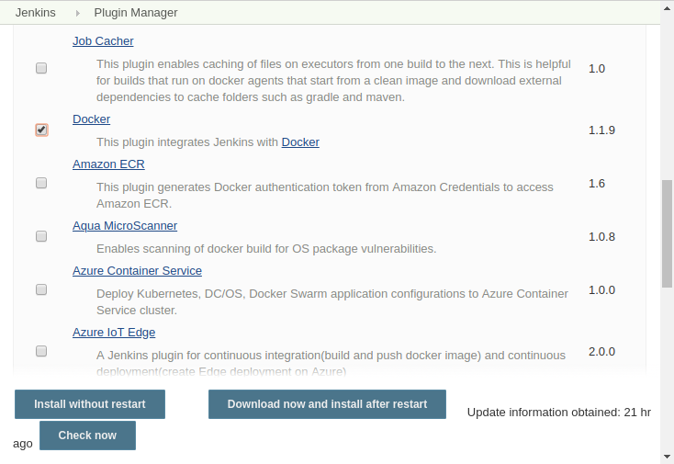
Jenkins and Docker
Docker plugin allows to use a docker host dynamically to provision build agents, run single build, tear-down agent. This plugin integrates Jenkins with Docker.
Notes:
Trainer Notes: Explain the slide

Slide 26
Deploying a Python Application
Problem statement: You have been asked to connect and deploy a python application to an application server.
Steps to perform:
Push code to GitHub repositories
Login to Jenkins
Create Jenkins job for Python
Run the job and deploy the app

Slide 27
Tomcat and Jenkins
Problem statement: You have been asked to connect and deploy a Java application on Tomcat using Jenkins.
Steps to perform:
Push code to GitHub repositories
Configure Tomcat
Login to Jenkins
Create Jenkins job for deployment
Run the job and deploy the app

Slide 28
PHP and Jenkins
Problem statement: You have been asked to connect and deploy a PHP application on Ant using Jenkins.
Steps to perform:
Push code to GitHub repositories
Login to Jenkins
Create Jenkins job for PHP
Run the job and deploy the app

Slide 29
Continuous Deployment is a development practice of releasing software on production servers continuously in an automated manner.
Continuous delivery is a process, where code changes are automatically built, tested, and prepared for production.
Smoke testing is a software testing method that determines whether the employed build is stable or not.

Slide 31
What is Continuous Deployment?
1
Continuous Deployment is a development practice where multiple developers are coding the same functionality.
Continuous Deployment is a development practice where you make the changes directly on the production server.
Continuous Deployment is a development practice of releasing software on production servers continuously in an automated manner.
Continuous Deployment is a development practice where you do all the development on the master branch.

Slide 32
What is Continuous Deployment?
1
Continuous Deployment is a development practice where multiple developers are coding the same functionality.
Continuous Deployment is a development practice where you make the changes directly on the production server.
Continuous Deployment is a development practice of releasing software on production servers continuously in an automated manner.
Continuous Deployment is a development practice where you do all the development on the master branch.
C
Continuous Deployment is a development practice of releasing software on production servers continuously in an automated manner.

Slide 33
Which of the following is true about Continuous Deployment?
2
Continuous Deployment ensures each deployment stage is quickly and reliably completed.
Continuous Deployment ensures frequent releases.
Continuous Deployment ensures releases are completed in smaller chunks.
Continuous Deployment allows instant responses for defects.

Slide 34
Which of the following is true about Continuous Deployment?
2
Continuous Deployment ensures each deployment stage is quickly and reliably completed.
Continuous Deployment ensures frequent releases.
Continuous Deployment ensures releases are completed in smaller chunks.
Continuous Deployment allows instant responses for defects.
C
Continuous Deployment ensures each deployment stage is quickly and reliably completed.

Slide 35
Smoke tests should be discreet and relatively fast.
3
True
False

Slide 36
Smoke tests should be discreet and relatively fast.
3
True
False
A
Smoke tests should be discreet and relatively fast.

Slide 37
Which of the following are the characteristics of Smoke testing? Select all that apply.
4
Smoke testing is always stable.
Smoke testing is scripted.
Smoke testing is not documented.
Smoke testing is type of regression testing.

Slide 38
Which of the following are the characteristics of Smoke testing? Select all that apply.
4
Smoke testing is always stable.
Smoke testing is scripted.
Smoke testing is not documented.
Smoke testing is type of regression testing.
The correct answers are
B and D
Smoke testing is scripted and it is a type of regression testing.

Slide 39
Hot deploy is the strategy where the application is deployed onto a running server.
5
True
False

Slide 40
Hot deploy is the strategy where the application is deployed onto a running server.
5
True
False
A
Hot deploy is the strategy where the application is deployed onto a running server. This is generally a fast and efficient way of getting your application online.

Slide 41

Triggering Parameterized Builds
Lesson-End Project
Deploying Maven App to Tomcat Server
Problem Statement:
You’re a DevOps engineer at Hooli, a computer vision company that started out as an image search platform. The company is celebrating its 25th anniversary and the CEO wants to celebrate the occasion by replacing the Hooli website with the original website that the company started out with for a day. You’re required to build a Maven web app that says “Welcome to Hooli”, set up a Tomcat server on an EC2 instance, set up a Jenkins pipeline to compile the app, and deploy it to Tomcat. The Jenkins job has to compile the app, generate a war file, and deploy the war file to the Tomcat server.
Requirements:
The app should be built with Maven.
The Tomcat server should allow remote deployment.
The pipeline should be built with the Maven Project plugin.
The build job should compile the app and do the deployment as a post-build action.
Problem Statement:
You’re a DevOps engineer at ChefHelp, which is a web and mobile-based app company that provides users with various recipes and cooking tips. The company wants to automate categorizing recipes. You’re required to set up a Jenkins job stream where a job gets triggered when a new recipe is added to the database. The job has to accept the file path as a parameter, run the program to find the category it belongs to, return the result and trigger another job to delete the recipe file from the server to avoid server space issues.
Requirements:
The program should accept the file path as a command line argument.
The parameterized build job should be designed to be triggered remotely.
The delete temps job should be triggered only if the build job succeeds.
Git Basics
Notes:
Trainer Notes: Explain the project to the learners, and instruct them to perform it after the lesson.

